Slide 1
SEVZI ZC467
Computer Networks
Contact Session – 2
Prabhu Subramanian

Slide 2

IMP Note to Self
Dr. Rama Satish K V, Visiting Professor, Wipro-WASE, Bengaluru

Slide 3
Important Note to Students
It is important to know that just login to the session does not guarantee the attendance.
Once you join the session, continue till the end to consider you as present in the class.
IMPORTANTLY, you need to make the class more interactive by responding to Professors queries in the session.
Whenever Professor calls your number / name, you need to respond, otherwise it will be considered as ABSENT
Dr. Rama Satish K V, Visiting Professor, Wipro-WASE, Bengaluru

Slide 4

The slides presented here are obtained from the authors of the books and from various other contributors. I hereby acknowledge all the contributors for their material and inputs.
I have added and modified a few slides to suit the requirements of the course.

Slide 5
Module 2 - Application Layer
Principle of Network Applications
The Web and HTTP Protocol
Email in the Internet
The Internet Directory Service - DNS
Peer-to-Peer Applications
Introduction to Socket Programming - with TCP and UDP
BITS Pilani, Deemed to be University under Section 3 of UGC Act, 1956

Slide 6
Application Layer
The application layer enables the user, whether human or software, to access the network.
File transfer, access, and management: This application allows a user to access files in a remote host.
Mail services: This application provides the basis for e-mail forwarding and storage.
Directory services: This application provides distributed database sources and access for global information about various objects and services.
Protocol: HTTP, FTP, TELNET, DNS, RLOGIN, SMTP
BITS Pilani, Deemed to be University under Section 3 of UGC Act, 1956

Slide 7

















Application Layer Protocols :
HTTP, FTP
Client-server architecture
server:
always-on host
permanent IP address
data centers for scaling
clients:
communicate with server
may be intermittently connected
may have dynamic IP addresses
do not communicate directly with each other
BITS Pilani, Deemed to be University under Section 3 of UGC Act, 1956

Slide 8
Application Layer Protocols : HTTP, FTP
P2P architecture
peer-peer
arbitrary end systems directly communicate
peers request service from other peers, provide service in return to other peers
  self scalability – new peers bring new service capacity, as well as new service demands
peers are intermittently connected and change IP addresses
  complex management
Highly scalable
But difficult to manage
BITS Pilani, Deemed to be University under Section 3 of UGC Act, 1956

Slide 9
Application Layer Protocols : HTTP, FTP
Process Communication
Process: program running within a host.
Within same host, two processes communicate using inter-process communication (defined by OS).
Processes in different hosts communicate by exchanging messages
Client process: process that initiates communication
Server process: process that waits to be contacted
Note: applications with P2P architectures have client processes & server processes
BITS Pilani, Deemed to be University under Section 3 of UGC Act, 1956

Slide 10
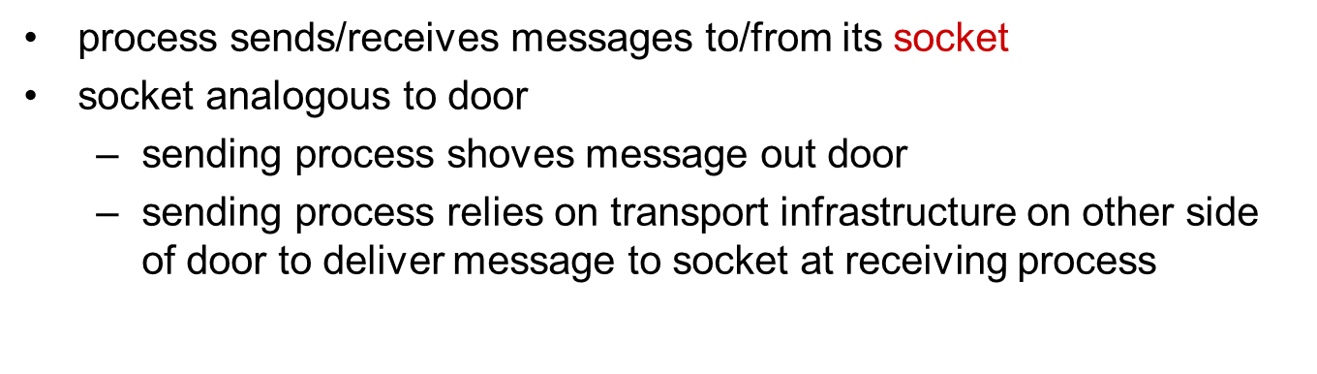
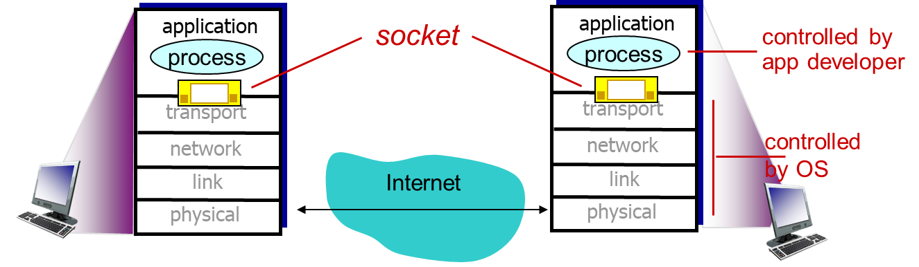
Application Layer Protocols : HTTP, FTP
Sockets
BITS Pilani, Deemed to be University under Section 3 of UGC Act, 1956

Slide 11
Port Numbers
Web Server
Mail Server
Port = 80
Port = 25
TCP
IP = 138.110.1.1
https://www.iana.org/assignments/service-names-port-numbers/service-names-port-numbers.xhtml
BITS Pilani, Deemed to be University under Section 3 of UGC Act, 1956

Slide 12
The Web and HTTP
Use of internet : (until 1990)
  To log in to remote hosts
  To transfer files from local hosts to remote hosts and vice versa
  To receive and send news, and
  To receive and send electronic mail.
Used by
  Researchers
  Academics, and
  University students
BITS Pilani, Deemed to be University under Section 3 of UGC Act, 1956

Slide 13
The Web and HTTP
In the early 1990s, a major new application arrived on the scene—the World Wide Web(WWW).
first Internet application that was used by public.
Used for interacting inside and outside their work environments
force users to tune in when the content provider makes the content available.
Easy for any individual to make information available over the Web
Hyperlinks and search engines help us navigate through an ocean of Web sites
Forms, JavaScript, Java applets, and many other devices enable us to interact with pages and sites.
Web serves as a platform for many killer applications emerging after 2003, including YouTube, Gmail, and Facebook.
BITS Pilani, Deemed to be University under Section 3 of UGC Act, 1956

Slide 14
Overview of HTTP
The Hyper Text Transfer Protocol (HTTP), the Web’s application-layer protocol, is at the heart of the Web.
HTTP is implemented in two programs: a client program and a server program.
The client program and server program, executing on different end systems, talk to each other by exchanging HTTP messages
HTTP defines the structure of these messages and how the client and server exchange the messages.
A Web page (also called a document) consists of objects.
An object is simply a file—such as an HTML file, a JPEG image, a Java applet, or a video clip that is addressable by URL
Most Web pages consist of a base HTML file and several referenced objects.
E.g. Web page contains HTML text and five JPEG images, then the Web page has six objects
BITS Pilani, Deemed to be University under Section 3 of UGC Act, 1956

Slide 15
Overview of HTTP
The base HTML file references the other objects in the page with the objects’ URLs.
Each URL has two components:
  the hostname of the server that houses the object and
  the object’s path name.
http://www.someSchool.edu/someDepartment/picture.gif
Web browsers (such as Internet Explorer and Firefox) implement the client side of HTTP.
Web servers, which implement the server side of HTTP, house Web objects, each addressable by a URL
  E.g. Apache and Microsoft Internet Information Server.
HTTP defines how Web clients request Web pages from Web servers and how servers transfer Web pages to clients
hostname
object’s path name
BITS Pilani, Deemed to be University under Section 3 of UGC Act, 1956

Slide 16
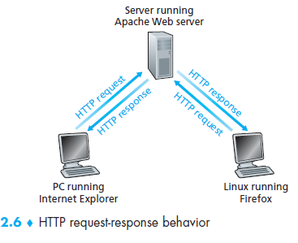
Overview of HTTP
When a user requests a Web page (clicks on a hyperlink), the browser sends HTTP request messages for the objects in the page to the server.
The server receives the requests and responds with HTTP response messages that contain the objects.
HTTP uses TCP as its underlying transport protocol.
The HTTP client first initiates a TCP connection with the server.
Once the connection is established, the browser and the server processes access TCP through their socket interfaces.
BITS Pilani, Deemed to be University under Section 3 of UGC Act, 1956

Slide 17
Overview of HTTP
HTTP Client :
sends HTTP request messages into its socket interface
and receives HTTP response messages from its socket interface.
HTTP server:
receives request messages from its socket interface
sends response messages into its socket interface.
BITS Pilani, Deemed to be University under Section 3 of UGC Act, 1956

Slide 18
Overview of HTTP
TCP provides a reliable data transfer service to HTTP
Each HTTP request message sent by a client process eventually arrives intact at the server
Each HTTP response message sent by the server process eventually arrives intact at the client.
HTTP need not worry about lost data or the details of how TCP recovers from loss or reordering of data within the network.
Because an HTTP server maintains no information about the clients, HTTP is said to be a stateless protocol (server maintains no information about past client requests).
BITS Pilani, Deemed to be University under Section 3 of UGC Act, 1956

Slide 19
HTTP connections : Non-Persistent and Persistent Connections
Client and server communicate for an extended period of time
Client making a series of requests and the server responding to each of the requests.
In client-server interaction is taking place over TCP, the application developer needs to make an important decision
  Should each request/response pair be sent over a separate TCP connection ? - non-persistent connections
  Should all of the requests and their corresponding responses be sent over the same TCP connection? - persistent connections
BITS Pilani, Deemed to be University under Section 3 of UGC Act, 1956

Slide 20
HTTP connections : Non-Persistent Connection
Suppose user enters URL www.someSchool.edu/someDepartment/home.index (contains text, references to 10 jpeg images)
1a. HTTP client initiates TCP connection to HTTP server (process) at www.someSchool.edu on port 80
1b. HTTP server at host www.someSchool.edu waiting for TCP connection at port 80. “accepts” connection, notifying client
2. HTTP client sends HTTP request message (containing URL) into TCP connection socket. Message indicates that client wants object someDepartment/home.index
3. HTTP server receives request message, forms response message containing requested object, and sends message into its socket
4. HTTP server closes TCP connection.
5. HTTP client receives response message containing html file, displays html. Parsing html file, finds 10 referenced jpeg objects
6. Steps 1-5 repeated for each of 10 jpeg objects
BITS Pilani, Deemed to be University under Section 3 of UGC Act, 1956

Slide 21
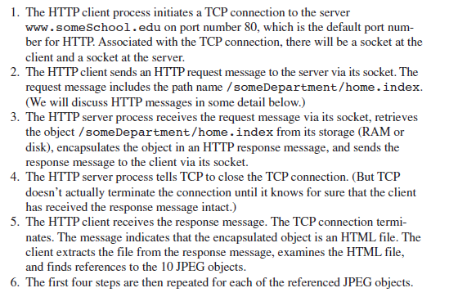
HTTP connections : Non-Persistent Connections
BITS Pilani, Deemed to be University under Section 3 of UGC Act, 1956

Slide 22
HTTP connections : Non-Persistent Connections
HTTP has nothing to do with how a Web page is interpreted by a client.
The HTTP specifications define only the communication protocol between the client HTTP program and the server HTTP program.
Each TCP connection is closed after the server sends the object
Each TCP connection transports exactly one request message and one response message.
BITS Pilani, Deemed to be University under Section 3 of UGC Act, 1956

Slide 23
HTTP connections : Non-Persistent Connections
Round-Trip Time (RTT):
The time it takes for a small packet to travel from client to server and then back to the client.
Includes following delays
  packet-propagation delays,
  packet queuing delays in intermediate routers and switches, and
  packet-processing delays.
BITS Pilani, Deemed to be University under Section 3 of UGC Act, 1956

Slide 24
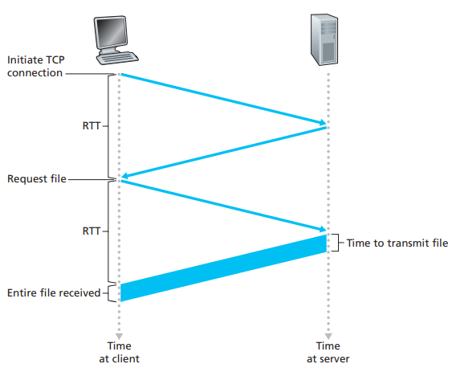
HTTP connections : Non-Persistent Connections
BITS Pilani, Deemed to be University under Section 3 of UGC Act, 1956

Slide 25
HTTP connections : Non-Persistent Connections
What happens when a user clicks on a hyperlink (URL)?
Browser initiate a TCP connection between the browser and the Web server (involves three-way handshake)
The client sends a small TCP segment to the server
The server acknowledges and responds with a small TCP segment, and,finally, the client acknowledges back to the server.
Step 1 and Step 2 – take One RTT
Step 3 - the client sends a small TCP segment to the server, the server acknowledges and responds with a small TCP segment, and, finally, the client acknowledges back to the server.
Once the request message arrives at the server, the server sends the HTML file into the TCP connection
BITS Pilani, Deemed to be University under Section 3 of UGC Act, 1956

Slide 26

HTTP connections : Non-Persistent Connections
Non-Persistent HTTP: Response time
Definition of RTT: time for a small packet to travel from client to server and back.
Response time:
one RTT to initiate TCP connection
one RTT for HTTP request and first few bytes of HTTP response to return
file transmission time
total = 2RTT+transmit time
initiate TCP
connection
RTT
request
file
RTT
time to
transmit
file
file
received
time
time
BITS Pilani, Deemed to be University under Section 3 of UGC Act, 1956

Slide 27
HTTP connections : Non-Persistent Connections
Non-Persistent HTTP: Response time
Suppose 10 images need to be downloaded from the HTTP server. The total time taken to request and download 10 images in a non-persistent and persistent connection is:
Non-persistent
2 RTT (Connection time) + 2 * 10 RTT= 22 RTT
BITS Pilani, Deemed to be University under Section 3 of UGC Act, 1956

Slide 28
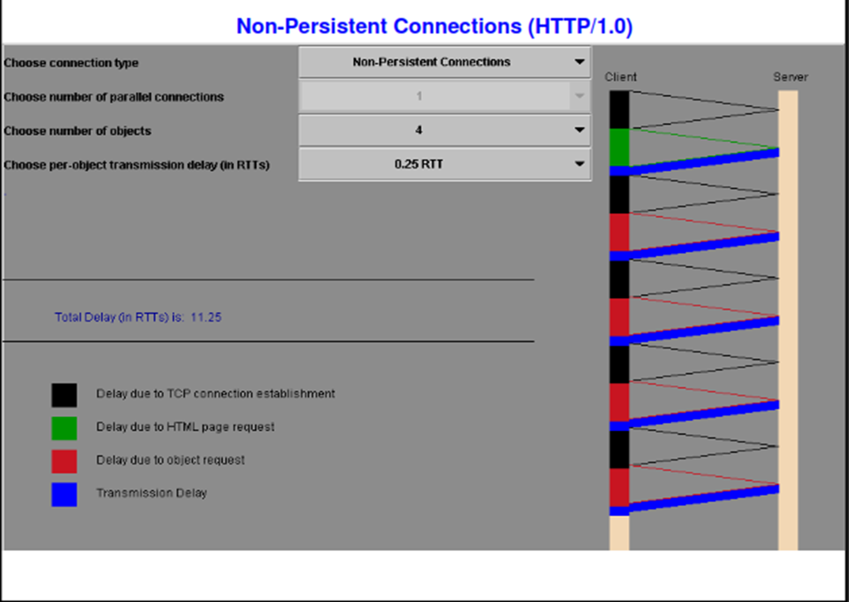
HTTP connections : Non-Persistent Connections
Non-Persistent HTTP: Response time – Simulation Demo for HTTP 1.0
BITS Pilani, Deemed to be University under Section 3 of UGC Act, 1956

Slide 29
HTTP connections : Persistent Connections
Shortcomings of Non-persistent connections:
New connection must be established and maintained for each requested object.
  Each of the connection TCP buffers must be allocated and TCP variables must be kept in both the client and server.
  Burden on the Web server, which may be serving requests from hundreds of different clients simultaneously
Each object suffers a delivery delay of two RTTs— one RTT to establish the TCP connection and one RTT to request and receive an object.
BITS Pilani, Deemed to be University under Section 3 of UGC Act, 1956

Slide 30
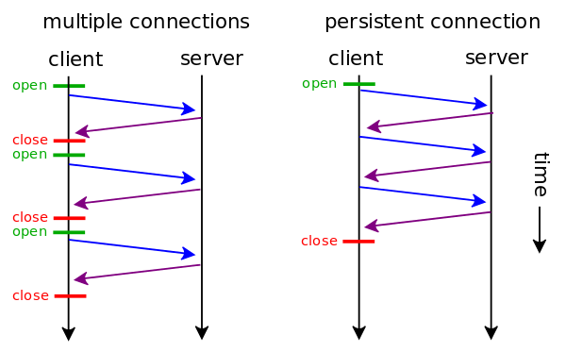
HTTP connections : Persistent Connections
Server leaves connection open after sending response
Subsequent HTTP messages between same client/server sent over open connection
Client sends requests as soon as it encounters a referenced object
As little as one RTT for all the referenced objects
Persistent: Needs 1 TCP connection
1 RTT+10 RTTs
BITS Pilani, Deemed to be University under Section 3 of UGC Act, 1956

Slide 31
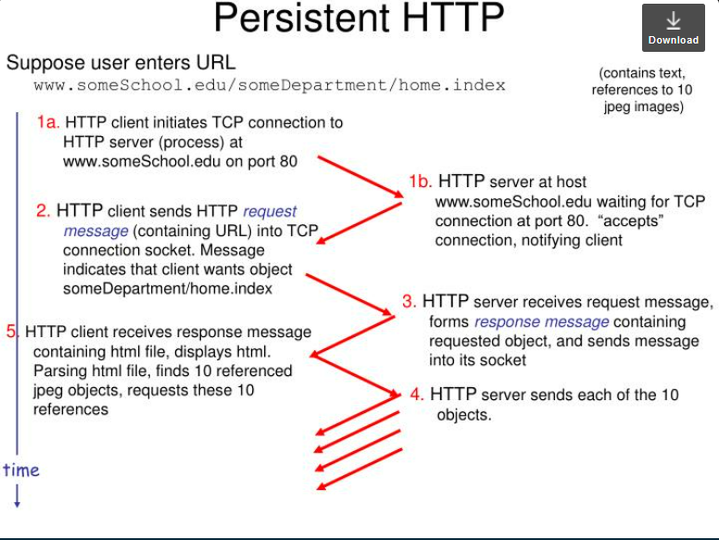
HTTP connections : Persistent Connections
BITS Pilani, Deemed to be University under Section 3 of UGC Act, 1956

Slide 32
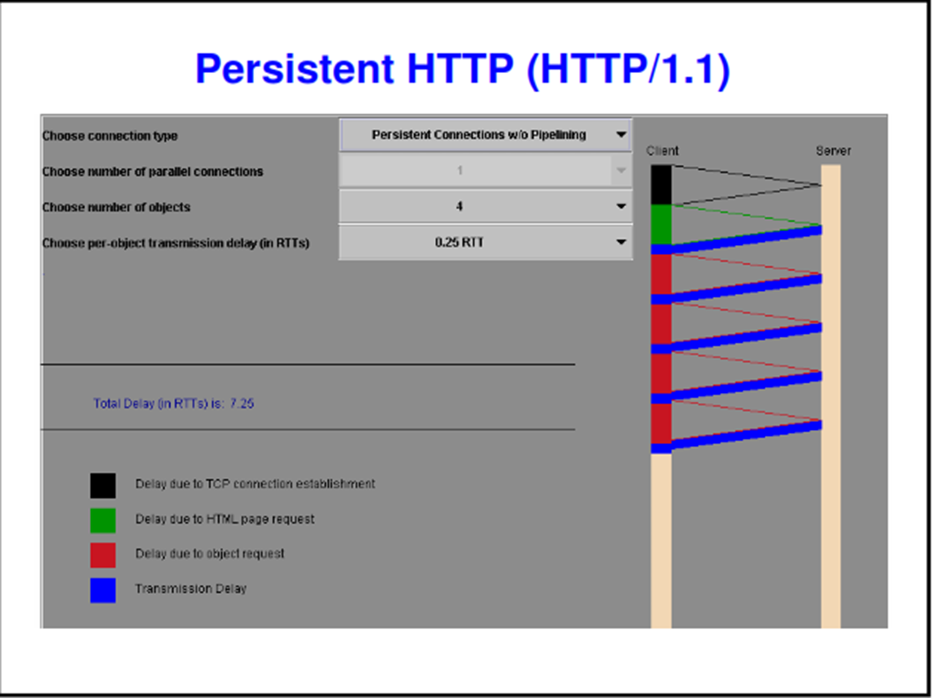
HTTP connections : Persistent Connections
BITS Pilani, Deemed to be University under Section 3 of UGC Act, 1956

Slide 33
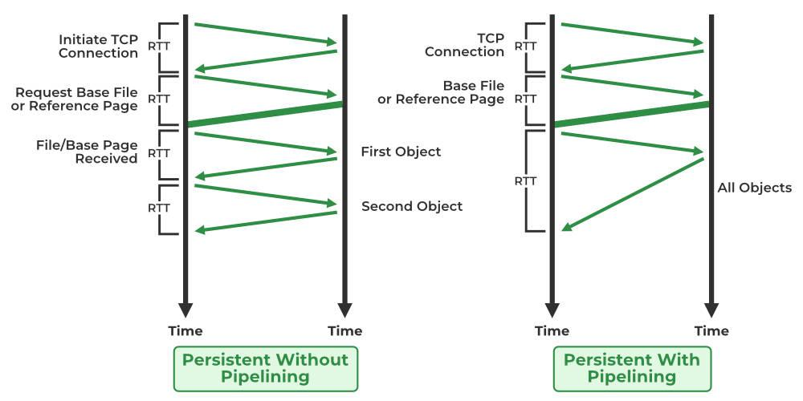
HTTP connections : Persistent Connections
Persistent Connection and Pipelining
BITS Pilani, Deemed to be University under Section 3 of UGC Act, 1956

Slide 34
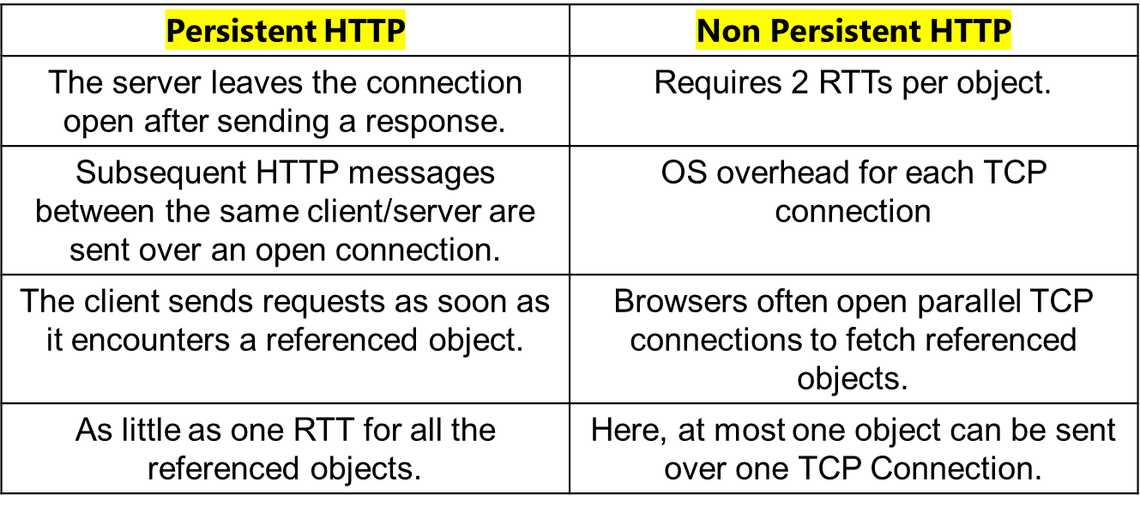
Persistent & Non Persistent HTTP

Slide 35
HTTP Message Format
The HTTP specifications include the definitions of the HTTP message formats.
There are two types of HTTP messages:
HTTP request messages and
HTTP response messages
BITS Pilani, Deemed to be University under Section 3 of UGC Act, 1956

Slide 36
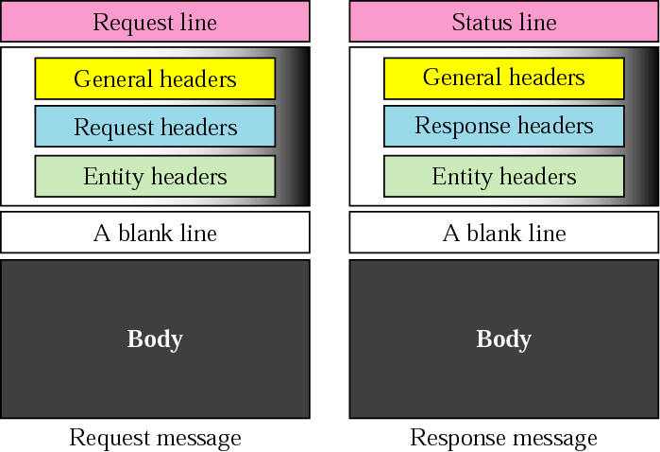
HTTP Request and Response

Slide 37
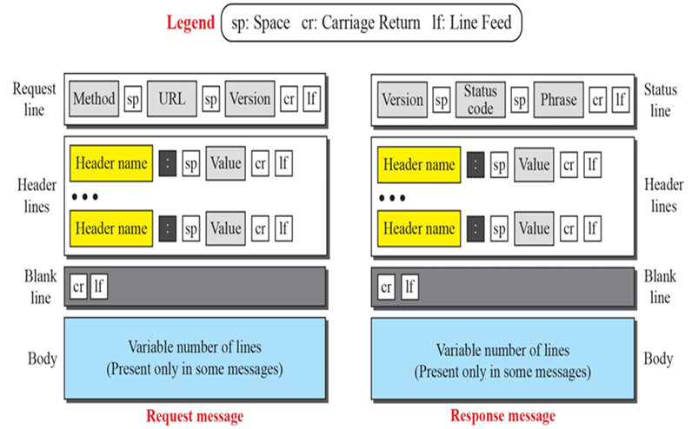
HTTP Request and Response

Slide 38
HTTP request message
two types of HTTP messages: request, response
HTTP request message:
  ASCII (human-readable format)
carriage return character
request line
(GET, POST,
HEAD commands)
line-feed character
GET /index.html HTTP/1.1\r\n
Host: www-net.cs.umass.edu\r\n
User-Agent: Firefox/3.6.10\r\n
Accept: text/html,application/xhtml+xml\r\n
Accept-Language: en-us,en;q=0.5\r\n
Accept-Encoding: gzip,deflate\r\n
Accept-Charset: ISO-8859-1,utf-8;q=0.7\r\n
Keep-Alive: 115\r\n
Connection: keep-alive\r\n
\r\n
header
lines
carriage return,
line feed at start
of line indicates
end of header lines

Slide 39
HTTP Message Format
HTTP Request Message :
The first line of an HTTP request message is called the request line; the subsequent lines are called the header lines.
The request line has three fields: the method field, the URL field, and the HTTP version field.
The method field can take on several different values, including GET, POST, HEAD, PUT, and DELETE.
The header line Host:www.someschool.edu specifies the host on which the object resides.
GET /somedir/page.html HTTP/1.1
Host: www.someschool.edu
Connection: close
User-agent: Mozilla/5.0
Accept-language: fr

Slide 40
HTTP Message Format
HTTP Request Message :
By including the Connection:close wants the server to close the connection after sending the requested object.
The User-agent: header line specifies the user agent, that is, the browser type that is making the request to the server. Here the user agent is Mozilla/5.0, a Firefox browser.
Finally, the Accept language:header indicates that the user prefers to receive a French version of the object, if such an object exists on the server; otherwise, the server should send its default version.
GET /somedir/page.html HTTP/1.1
Host: www.someschool.edu
Connection: close
User-agent: Mozilla/5.0
Accept-language: fr

Slide 41
HTTP Message Format
HTTP Response Message :
It has three sections: an initial status line, six header lines, and then the entity body
The entity body is the meat of the message—it contains the requested object itself (represented by data data data data data ...).
HTTP/1.1 200 OK
Connection: close
Date: Tue, 09 Aug 2011 15:44:04 GMT
Server: Apache/2.2.3 (CentOS)
Last-Modified: Tue, 09 Aug 2011 15:11:03 GMT
Content-Length: 6821
Content-Type: text/html
(data data data data data ...)

Slide 42
HTTP Message Format
HTTP Response Message :
The status line has three fields: the protocol version field, a status code, and a corresponding status message.
In this example, the status line indicates that the server is using HTTP/1.1 and that everything is OK (that is, the server has found, and is sending, the requested object).
The Date: header line indicates the time and date when the HTTP response was created and sent by the server.
HTTP/1.1 200 OK
Connection: close
Date: Tue, 09 Aug 2011 15:44:04 GMT
Server: Apache/2.2.3 (CentOS)
Last-Modified: Tue, 09 Aug 2011 15:11:03 GMT
Content-Length: 6821
Content-Type: text/html
(data data data data data ...)

Slide 43
HTTP Message Format
HTTP Response Message :
The Server: header line indicates that the message was generated by an Apache Web server; it is analogous to the User-agent: header line in the HTTP request message.
The Last-Modified: header line indicates the time and date when the object was created or last modified.
HTTP/1.1 200 OK
Connection: close
Date: Tue, 09 Aug 2011 15:44:04 GMT
Server: Apache/2.2.3 (CentOS)
Last-Modified: Tue, 09 Aug 2011 15:11:03 GMT
Content-Length: 6821
Content-Type: text/html
(data data data data data ...)

Slide 44
HTTP Message Format
HTTP Response Message :
The Content-Length: header line indicates the number of bytes in the object being sent.
The Content-Type: header line indicates that the object in the entity body is HTML text
HTTP/1.1 200 OK
Connection: close
Date: Tue, 09 Aug 2011 15:44:04 GMT
Server: Apache/2.2.3 (CentOS)
Last-Modified: Tue, 09 Aug 2011 15:11:03 GMT
Content-Length: 6821
Content-Type: text/html
(data data data data data ...)

Slide 45
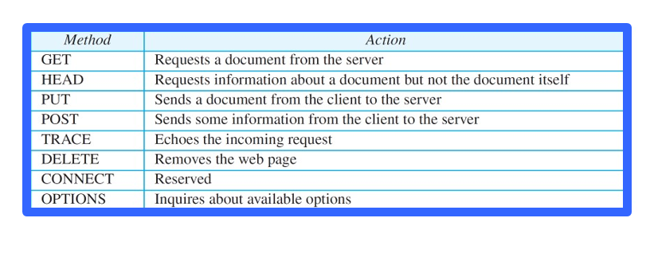
HTTP Methods

Slide 46
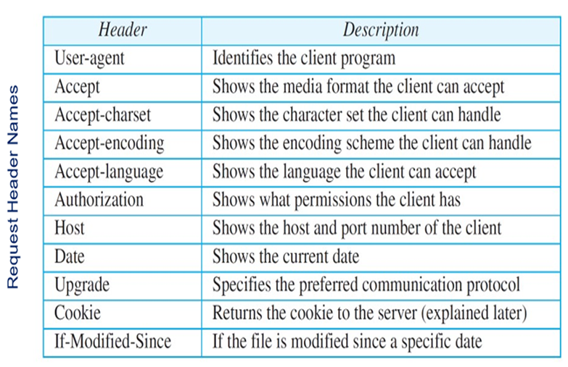
Request Header Names

Slide 47
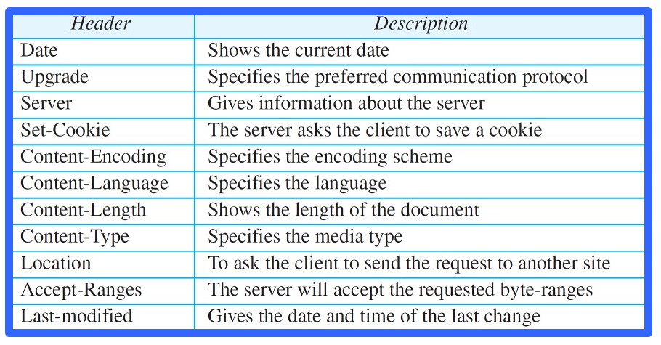
Response Header Names

Slide 48
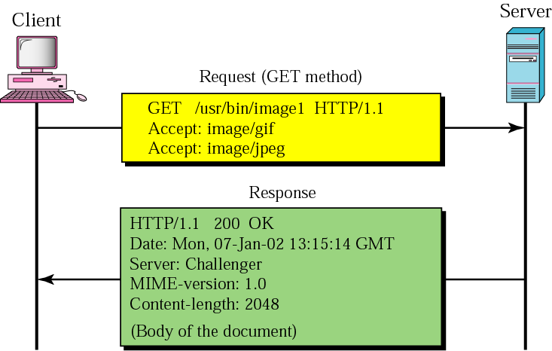
Example 1
This example retrieves a document. We use the GET method to retrieve an image with the path /usr/bin/image1. The request line shows the method (GET), the URL, and the HTTP version (1.1). The header has two lines that show that the client can accept images in GIF and JPEG format. The request does not have a body. The response message contains the status line and four lines of header. The header lines define the date, server, MIME version, and length of the document. The body of the document follows the header
BITS Pilani, Deemed to be University under Section 3 of UGC Act, 1956

Slide 49
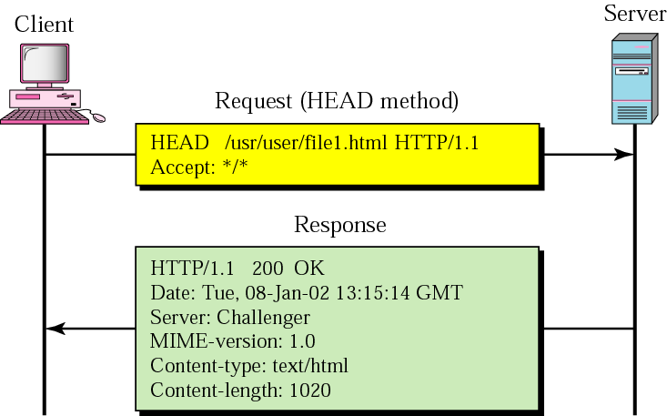
Example 2
This example retrieves information about a document. We use the HEAD method to retrieve information about an HTML document (see the next section). The request line shows the method (HEAD), URL, and HTTP version (1.1). The header is one line showing that the client can accept the document in any format (wild card). The request does not have a body. The response message contains the status line and five lines of header. The header lines define the date, server, MIME version, type of document, and length of the document
BITS Pilani, Deemed to be University under Section 3 of UGC Act, 1956

Slide 50
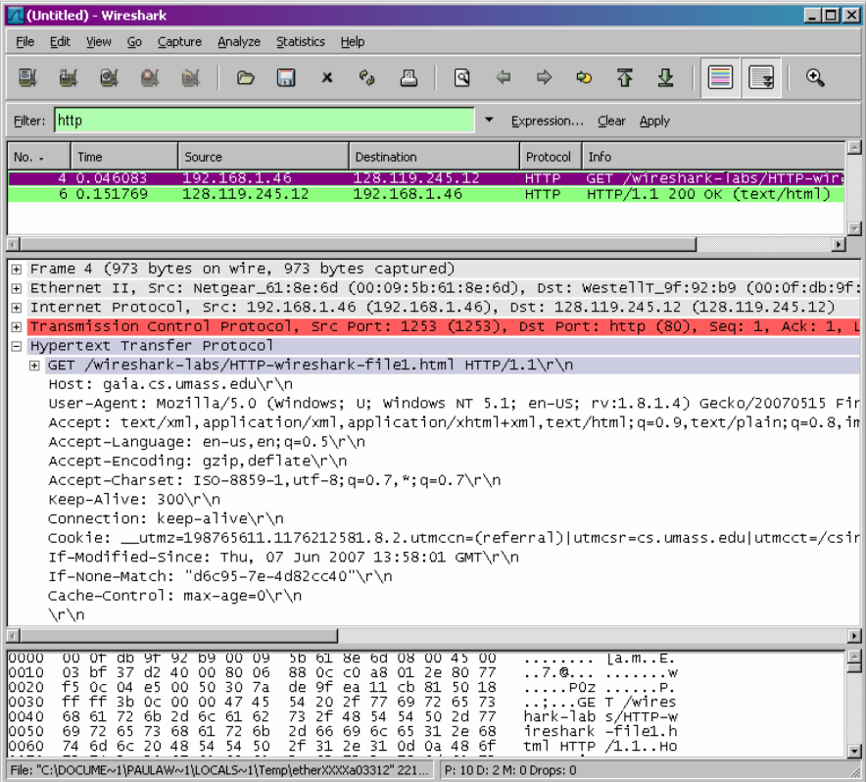
Wireshark Example
BITS Pilani, Deemed to be University under Section 3 of UGC Act, 1956

Slide 51
HTTP response status codes
In first line in server->client response message.
A few sample codes:
200 OK
  request succeeded, requested object later in this message
301 Moved Permanently
  requested object moved, new location specified later in this message (Location:)
400 Bad Request
  request message not understood by server
404 Not Found
  requested document not found on this server
505 HTTP Version Not Supported
BITS Pilani, Deemed to be University under Section 3 of UGC Act, 1956

Slide 52
File Transfer: FTP
Why do we need a FTP Service?
Purpose: To Transfer files between two computers
Goals of FTP Service
  Promote sharing of files (programs and/or data)
  Encourage indirect/implicit use of remote computers
  Shield users from variations in file storage among hosts
  Transfer data reliably and efficiently
BITS Pilani, Deemed to be University under Section 3 of UGC Act, 1956

Slide 53
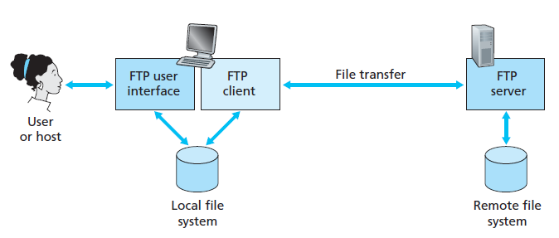
File Transfer: FTP
FTP session allows user to transfer files to or from a remote host.
To access user must provide a user identification and a password.
FTP moves files between local and remote file systems
BITS Pilani, Deemed to be University under Section 3 of UGC Act, 1956

Slide 54
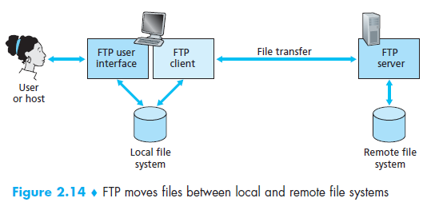
File Transfer: FTP
User interacts with FTP through an FTP user agent.
User provides the hostname of the remote host, causing the FTP client process in the local host to establish a TCP connection with the FTP server process in the remote host
The user then provides the user identification and password, which are sent over the TCP connection as part of FTP commands.
BITS Pilani, Deemed to be University under Section 3 of UGC Act, 1956

Slide 55
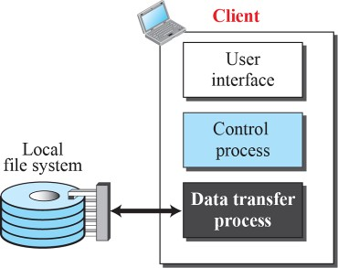
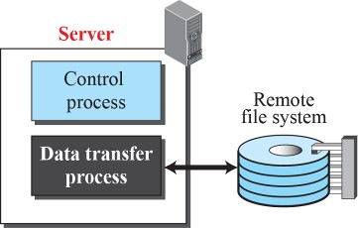
File Transfer Protocol (FTP)
Control
connection
Data
connection

Slide 56
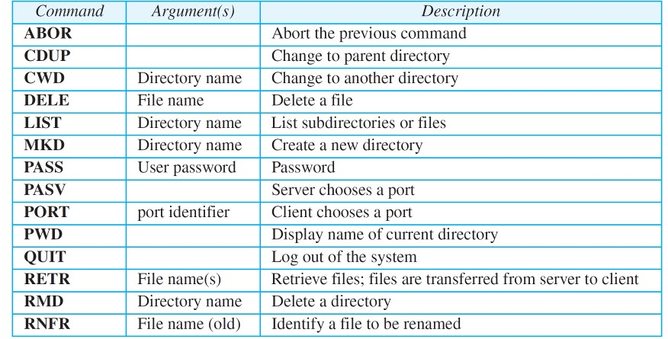
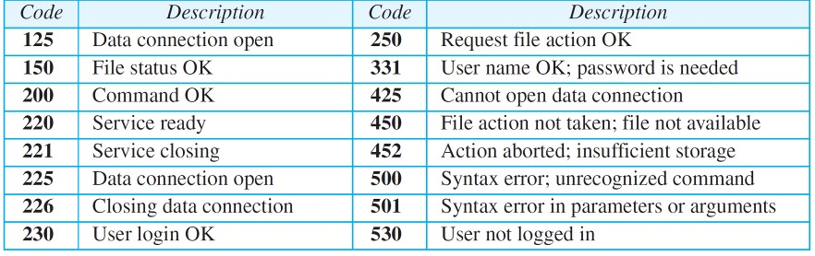
Some FTP Commands and Responses

Slide 57


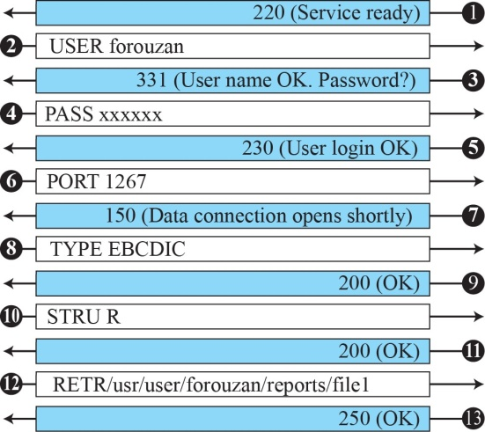
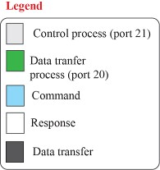

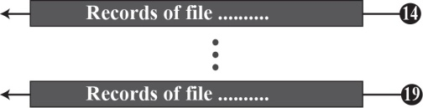
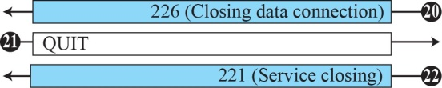
An Example

Slide 58


FTP’s Connections
2
* Persistent command
and reply connection
* Insulates users from “raw”
FTP commands
client
Non-persistent data
connection
Server is listening on port 21
for connection requests
*Server uses port 20
for data connections
* Routes “raw” FTP commands
* Receives server’s replies
User
Interface
server
User
Protocol
Interpreter
Control
Connection
Server
Protocol
Interpreter
21
User
Data Transfer
Function
Data
Connection
Server
Data Transfer
Function
20

Slide 59
FTP’s Connections – Establishment
2
ftp> open strauss.udel.edu
Connected to strauss.udel.edu
220 strauss FTP server ready.
client
331 Password req for lucasb.
Password:
User
Interface
230 User lucasb logged in.
ftp>
USER lucasb
PASS mypass
server
User
Protocol
Interpreter
Control
Connection
Server
Protocol
Interpreter
User
Data Transfer
Function
Data
Connection
Server
Data Transfer
Function

Slide 60

FTP’s Connections
Data Transfer
2
client
ls client.txt
-rw-r--r-- lucasb client.txt
User
Interface
128.4.40.17 (19×256)+137
128.4.40.17:5001
226 Closing Data Connection
128.4.40.17 19,137
200 Port Command Sucessful
LIST client.txt
PORT 128,4,40,17,19,137
150 Data Connection will be open shortly
server
User
Protocol
Interpreter
User
Protocol
Interpreter
Server
Protocol
Interpreter
Control
Connection
Server
Protocol
Interpreter
Passive open on
Port 5001
User
Data Transfer
Function
Data
Connection
Server
Data Transfer
Function
Establish Data Connection

Slide 61
FTP’s Connections – Connection Closing
2
bye
client
User
Interface
221 Service Closing
QUIT
server
User
Protocol
Interpreter
Control
Connection
Server
Protocol
Interpreter
User
Data Transfer
Function
Data
Connection
Server
Data Transfer
Function

Slide 62
Thank You!

